Slide 1
Block Chains and Applications
Daniel J. Mashao, PhD
State Information Technology Agency (SITA), reporting to the Ministry of Telecommunications and Postal Services
16 October 2016

Slide 2
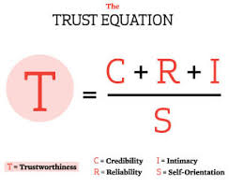
Alternative Title of This will
TRUST

Slide 3
What is Trust?
Trust is CRII over ME
Trust = Credibility*Reliability*Integrity*Intimacy/ME
If ME is too high, that reduces Trust; If I get the sense that you are interacting with me with only yourself in mind, then that lessens trust
Higher the credibility, the reliability and the Integrity the higher the trust.

Slide 4
TRUST
There are many things you will not be able to do without Trust
You cannot leave your home, unless you have faith that you will come back safely,
Lack of trust may allow you to engage in small things, but not big things

Slide 5
INTERNET as we Have it Currently
Internet is about connectivity, you do not know who is connecting with you and you may not know their intentions
To connect you do not need to trust, but to transact you will need to have trust

Slide 6
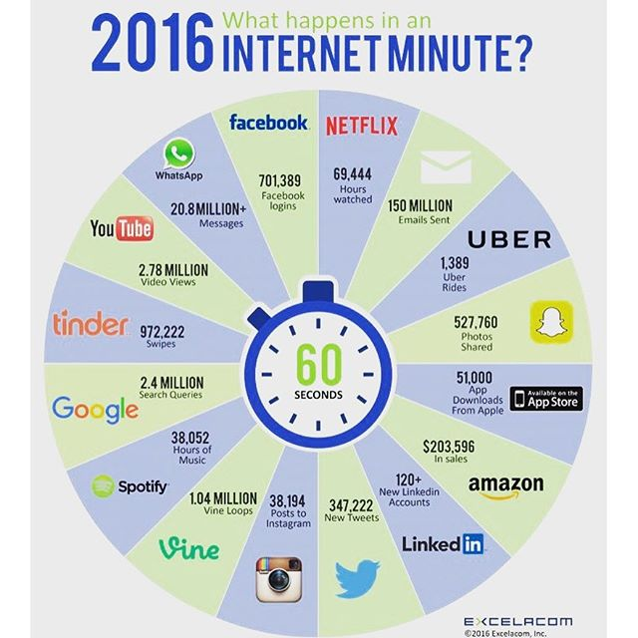

Slide 7
Trust is now in Fashion
Applications that are trending and actually uses Trust
Uber
Get into a taxi; you can trust that in addition to convenience
Someone is monitoring the taxi driver, someone knows that they are genuine
There are other people reviews of the taxi driver, etc
Airbnb
Sleep in strangers home;
You can get reviews about other people previous experience
The role of trust is critical and there is a level of comfort that is being introduced

Slide 8
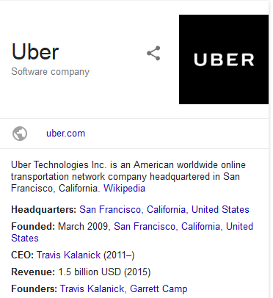
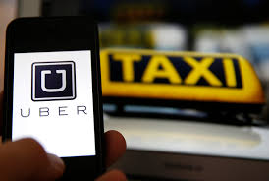
Examples of Trust

Slide 9
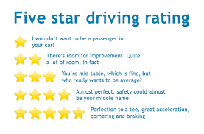
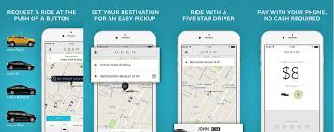

Slide 10
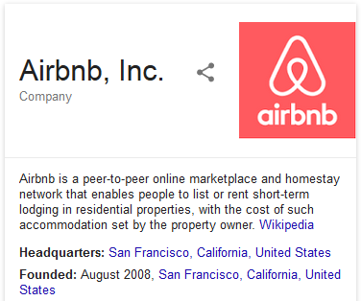
Example of Trust

Slide 11
Model of Trust Currently
The current model of trust is based on having some sole authority; a central server or system that can give authority
Single point of failure is introduced
SWIFT System used by Banks
The Society for Worldwide Interbank Financial Telecommunication (SWIFT) provides a network that enables financial institutions worldwide to send and receive information about financial transactions in a secure, standardized and reliable environment

Slide 12
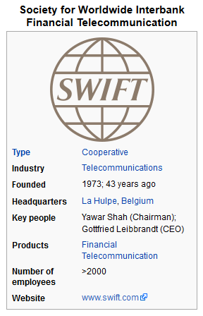
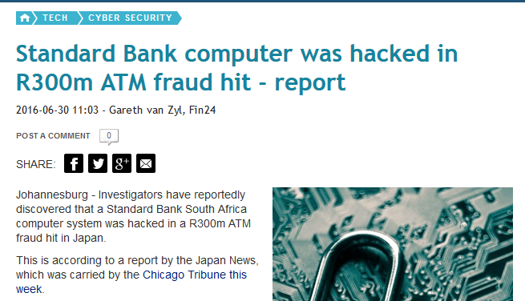
SWIFT as an Example of a Single Authority

Slide 13
What is Special About Block Chains and Bitcoins
Trust built from common internet technologies
Decentralized authorization
Provable confidence

Slide 14
Block Chain Technologies
Bittorent: A communications protocol for peer-to-peer file sharing
Typically used to download large files
10mbps
1mbps

Slide 15
With BitTorrent
1mbps
10mbps
1mbps
1mbps
The receiver also becomes the supplier!!

Slide 16
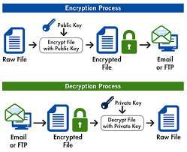
Block Chains Technology
Pretty Good Privacy: Private-Public Key Infrastructure
Allows you to send information/messages that can be read by only the intended recipient and no one else who does not have the recipient private key.

Slide 17
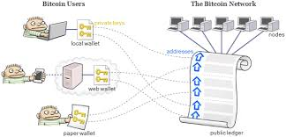
Block Chains Technologies
Public Ledger

Slide 18
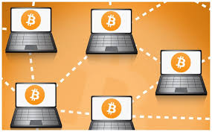
Block Chains System
Now a transaction has to be provided to several servers to check for accuracy and to check that the Bitcoin is valid.
This check is done by bit-miners;
The first bit-miner is rewarded for discovering that the transaction is valid.

Slide 19
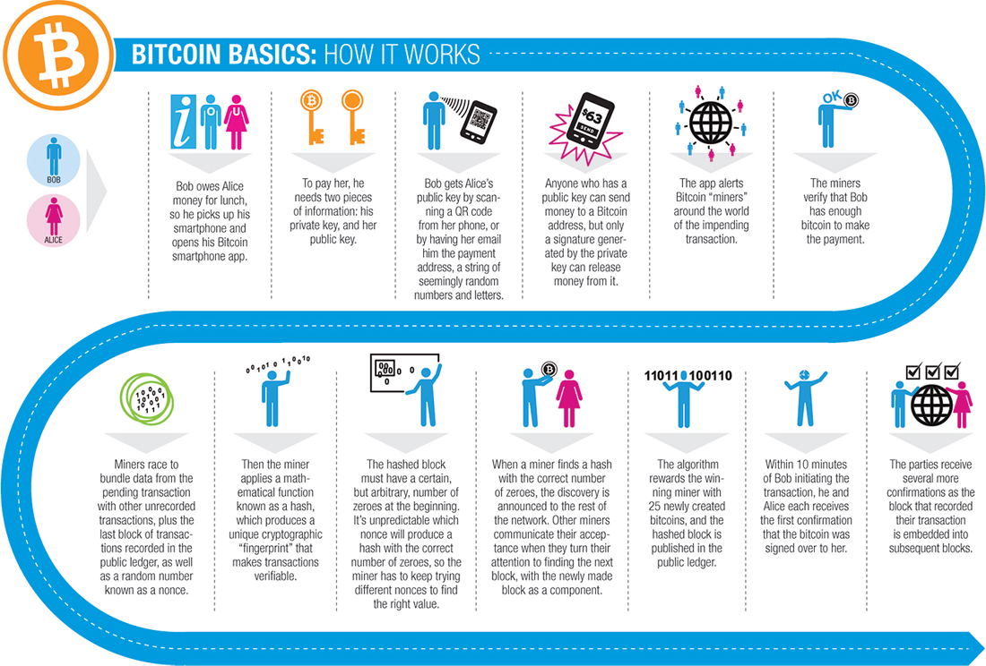

Slide 20
POTENTIAL USES OF BLOCK CHAINS
Financial | Public Records | Private Records | Semi-Public Records | Physical Assets Keys
Currency | Land titles | Contracts | Degrees | Home Keys
Private Equities | Vehicle Registries | Signatures | Learning Outcomes | Vacation Home
Public Equities | Business Licence | Wills | Medical Records | Hotel Rooms
Bonds | Criminal Records | Trusts | Genome Data
Spending Records | Passports | Escrows
Trading Records | Certificates | GPS trails
Crowd Funding | Permits
List from http://www.the-blockchain.com/potential-uses-of-blockchain/

Slide 21
Applications in Government
Declaration of Interests [Government] – SITA has developed an app that allows civil servants to declare their interests online. Block chains can add the signature of the manager to confirm that the supervisor has reviewed block chains
SASSA Grants [Government]– these are meant to assist children; parents could be using them for other things. The grants can be provided in the form of block chains so that they can be traced for what they were used for. Nearly like DOA
Company rewards [SITA]; to ensure that rewards can only be used in the company
US Food Stamps

Slide 22
Some of the Benefits of Block Chains
Trust less lending
Strangers can lend you money over the internet; they do not have to trust you.
Reduction in Litigations
57% of litigations (44% in US) in UK is about contract disputes; smart contracts done with block chains can provide irrefutable evidences e.g. when was contract changed and what was the change [reference 54 in Blockchains]
Title deeds for Houses and Motor Vehicles
Ideally suited to Block chains. – enable speedy transactions

Slide 23
Thank you

